Slide 1

王业伟的第七次报告
王业伟
2019年4月

Slide 2
目录 Contents
1
Introduction
2
Architecture
3
Network
4
Component
5
Evaluation

Slide 3
Introduction
SMR
Three steps of transaction flow
(1) Executing a transaction and checking its correctness, thereby endorsing it
(2) ordering through a consensus protocol, irrespective of transaction
Semantics
(3) transaction validation per application-specific trust assumptions
A set of States
A set of Inputs
A set of Outputs
A transition function (Input × State → State)
An output function (Input × State → Output)
A distinguished State called Start.
Passive replication：the pre-consensus computation of state updates
Active replication：the post-consensus validation of execution results and state changes
Hybrid replication design, which mixes passive and active replication in the Byzantine model, and the execute-order validate paradigm, represent the main innovation in Fabric architecture.

Slide 4
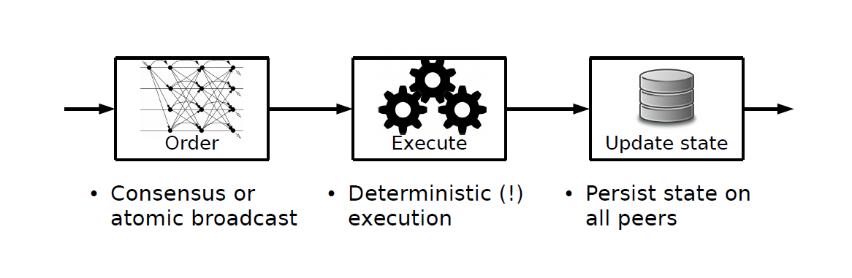
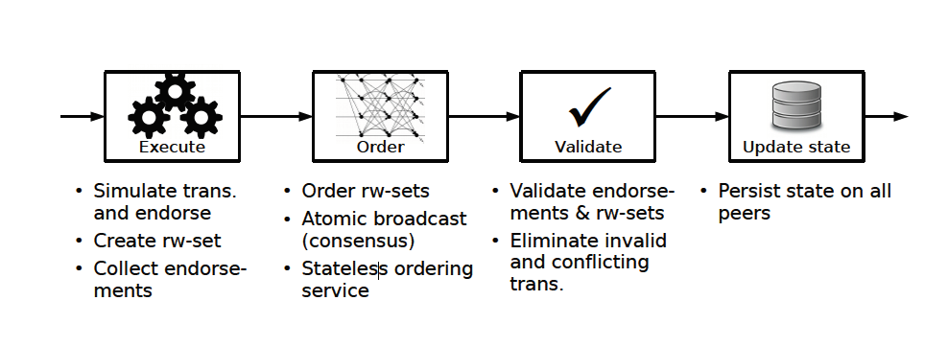
Architecture
Order-execute
Execute-order-validate

Slide 5
Architecture
Sequential execution
Non-deterministic
Condentiality of execution
Order-execute
block containing valid transactions
solve a PoW
disseminates the block
repeats the execution
Transaction on smart contracts are typically executed after consensus or entwined with it

Slide 6
Architecture
Execute-order-validate
sends transactions
endorsement
orders transaction outputs
endorsed transactions
· A smart contract, called chaincode
· A endorsement policy（Every chaincode has an endorsement policy）
passive replication：the pre-consensus computation of state updates
active replication ：the post-consensus validation of execution results and state changes
hybrid
replication

Slide 7
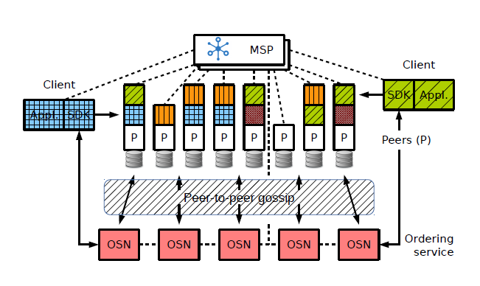
Network
MSP: modular membership service provider
Clients: submit transaction proposals; orchestrate the execution phase; broadcast
Peers： execute transaction proposals and validate transactions（endorsing peers）；maintain the blockchain ledger
Ordering Service Nodes (OSN)：establishes the total order of all transactions；contains state updates，dependencies computed and cryptographic signatures
Orderers are entirely unaware of the application state, and do not participate in the execution nor in the validation of transactions.

Slide 8
Network
Partition the state of the blockchain network
Ordering service
Channel
channel
channel
channel
Consensus not coordinated
The total order of transactions
separate from the others

Slide 9
Execution Phase
the identifier of the chaincode
the identity of the submitting client
Transaction proposal
Parameters of the chaincode
the transaction payload
a nonce for each client
transaction identier

Slide 10
Execution Phase
Clients sign and send the transaction proposal
The endorsers simulate the proposal
PTM maintains the state in the form of a versioned key-value store
a result of the simulation
a value writeset & readset
client collects endorsements
Chaincode operation
GetState, PutState, and DelState
endorsement
readset
writeset
Metadata
Metadata
transaction ID
endorser ID
endorser signature

Slide 11
Ordering Phase
Execution Phase
enough endorsements
assembles a transaction & submits this to OS
the transaction payload
transaction metadata
establishes a total order on all submitted transactions per channel
endorsements

Slide 12
Ordering Phase
The ordering service batches multiple transactions into blocks and outputs a hash-chained sequence of blocks containing transactions
Grouping or batching transactions into blocks improves the throughput
of the broadcast protocol
2 operations for ordering service
broadcast(tx)
B ← deliver(s)
Safety properties for each channel
Agreement
Hash chain integrity
No skipping
No creation
Validity

Slide 13
Validation Phase
Blocks are delivered to peers
endorsement policy evaluation(validation system chaincode (VSCC))
read-write conict check
ledger update phase

Slide 14
Validation Phase
Blocks are delivered to peers
endorsement policy evaluation(validation system chaincode (VSCC))
read-write conict check
ledger update phase

Slide 15
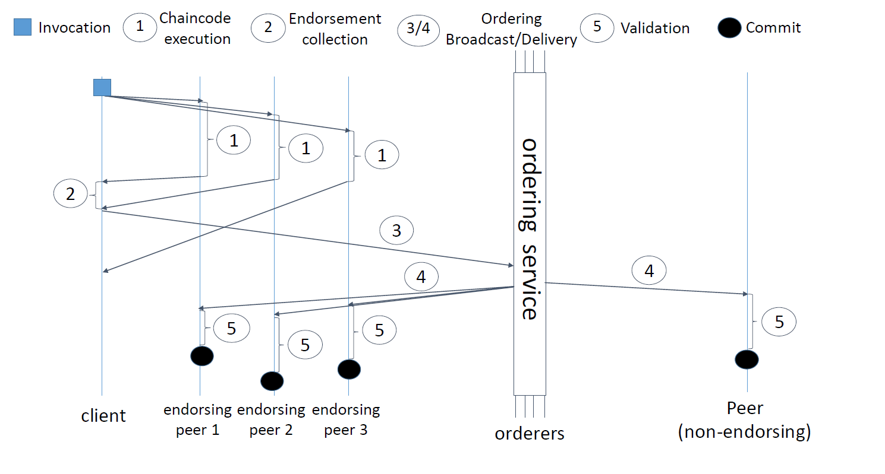
Transaction flow

Slide 16
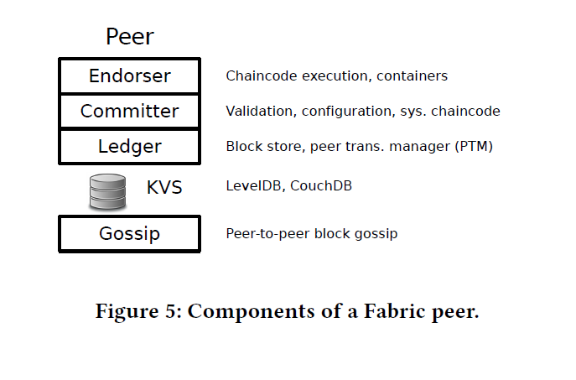
Component
Fabric is written in Go and uses the gRPC framework [6] for communication between clients, peers, and orderers.

Slide 17
Membership Service
The membership service provider (MSP) maintains the identities of
all nodes in the system (clients, peers, and OSNs) and is responsible
for issuing node credentials that are used for authentication and
authorization.
authenticate transactions
verify the integrity of transactions
sign and validate endorsements
authenticate other blockchain operations
key management registration of nodes
Fabric-CA allows two modes
Offline mode
Generate credentials
Online mode
issues cryptographic credentials
to enrolling clients
MSP can accommodate commercial certification authorities (CAs).
A stand-alone CA is provided as well with Fabric, called Fabric-CA.
MSP permits identity federation.

Slide 18
Ordering Service
The ordering service is bootstrapped with a genesis block on the
system channel
(1)Atomic broadcast
(2) Reconfiguration of a channel
(3) access control
Kafka for using
Solo for development
BFT-SMaRt is a proof-of-concept
Apache Kafka provides atomic
broadcast function，which offers scalable publish-subscribe messaging and strong consistency despite node crashes，based on ZooKeeper
The OSNs act as proxies between the peers and Kafka.

Slide 19
Peer Gossip
The communication layer for gossip is based on gRPC and utilizes TLS with mutual authentication, which enables each side to bind the TLS credentials to the identity of the remote peer.
two phases for information dissemination:
Push :forward messages randomly
Pull :probes messages randomly
In order to reduce the load of sending blocks from the ordering nodes to the network, the protocol also elects a leader peer that pulls blocks from the ordering service on their behalf and initiates the gossip distribution.

Slide 20
Ledger
maintains the ledger and the state on persistent storage and enables simulation, validation, and ledger-update phases
ledger
block store
PTM
readset
Getstate → record
writeset
Putstate → update
query
Compute & add to readset
indices
transaction
PTM maintains the latest state in a versioned key-value store. one tuple of the form
(key, val, ver)
Version maintains the latest state in a versioned key-value store

Slide 21
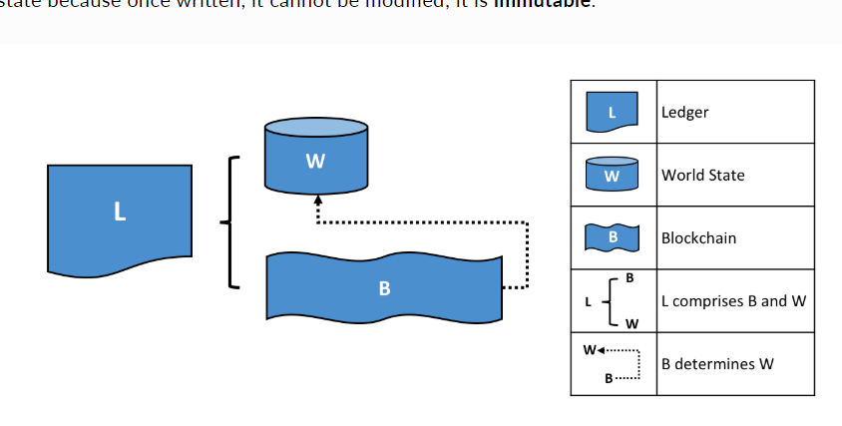
ledger

Slide 22
Chaincode
channel
(1) definitions of the MSPs for the
participating nodes
(2) the network addresses of the OSNs
(3)shared configuration for the consensus implementation and the ordering
service, such as batch size and timeouts,
(4) rules governing access to the ordering service operations (broadcast, and deliver),
(5) rules governing how each part the channel configuration
may be modified

Slide 23
EVALUATION
Fabric Coin
UTXO cryptocurrencies
If two transactions attempt to assign the same unspent coin state to a new owner, both would pass the VSCC logic but would be caught subsequently in the read-write conflict check performed by the PTM. The PTM verifies that the current version number stored in the ledger matches the one in the readset.

Slide 24
EVALUATION
Experiments
Version : Fabric v1.1.0
Network : IBM cloud dedicated VMs ,1Gbps networking
Machine :16核 2GHz 内存8GB
single-channel ordering service - 3 zookeeper nodes –
4 Kafka brokers – 3 fabric orders
Signature： 256-bit ECDSA scheme

Slide 25
谢 谢！

